Slide 1


SMART LIBRARY MANAGEMENT
PRESENTED BY-
ARPAN BANDHYOPADHAY(12200318067)
SASWATA DAS(12200318033)
SOUVIK SRIMANI(12200318020)
ABHIRUP RAY(12200318071)
UNDER THE GUIDANCE OF-
DR.JUIN ACHARJEE
ASSISTANT PROFESSOR
DEPARTMENT of ECE
St. Thomas’ College of Engineering and Technology

Slide 2

OUTLINE
OBJECTIVE
INTRODUCTION
LITERATURE SURVEY
SOFTWARE PLATFORM
BLOCK DIAGRAM
CIRCUIT DIAGRAM AND COMPONENTS
RESULT AND ANALYSIS
FUTURE ASPECTS
CONCLUSION
OBJECTIVE
INTRODUCTION
LITERATURE SURVEY
SOFTWARE PLATFORM
BLOCK DIAGRAM
CIRCUIT DIAGRAM AND COMPONENTS
RESULT AND ANALYSIS
FUTURE ASPECTS
CONCLUSION

Slide 3



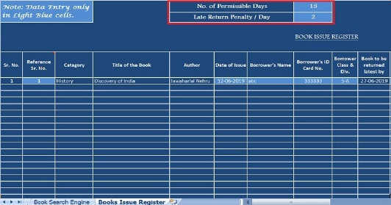
OBJECTIVE
OBJECTIVE
INTRODUCTION
LITERATURE SURVEY
SOFTWARE PLATFORM
BLOCK DIAGRAM
CIRCUIT DIAGRAM AND COMPONENTS
RESULT AND ANALYSIS
FUTURE ASPECTS
CONCLUSION
Modernize library experience
Keeping the reports of library stocks
Keeping the tracks of the readers entering the library
Ease of issuing and returning of books

Slide 4
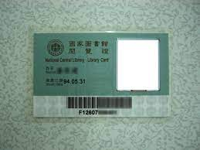


INTRODUCTION
OBJECTIVE
INTRODUCTION
LITERATURE SURVEY
SOFTWARE PLATFORM
BLOCK DIAGRAM
CIRCUIT DIAGRAM AND COMPONENTS
RESULT AND ANALYSIS
FUTURE ASPECTS
CONCLUSION
SCANNING LIBRARY CARD
ISSUING BOOKS
TURNING LIBRARIAN’S JOB EASY

Slide 5
LITERATURE SURVEY
OBJECTIVE
INTRODUCTION
LITERATURE SURVEY
SOFTWARE PLATFORM
BLOCK DIAGRAM
CIRCUIT DIAGRAM AND COMPONENTS
RESULT AND ANALYSIS
FUTURE ASPECTS
CONCLUSION
Library in Everyone’s Pocket
[Gupta, M., & Jetty, S. (2018). Library in Everyone’s Pocket With reference to Bundelkhand University App. 2018 5th International Symposium on Emerging Trends and Technologies in Libraries and Information Services (ETTLIS).]
Analysis of Digital Library
[DiHu Haidong, Pan Dandan, & Wang Fangfang. (2011). Analysis of digital library information services. 2011 IEEE International Symposium on IT in Medicine and Education.]
Digital Library of Technology Focus using Dspace
[Arora, D. (2018). Building Digital Library of Technology Focus Using Dspace. 2018 5th International Symposium on Emerging Trends and Technologies in Libraries and Information Services (ETTLIS).]

Slide 6
OBJECTIVE
INTRODUCTION
LITERATURE SURVEY
SOFTWARE PLATFORM
BLOCK DIAGRAM
CIRCUIT DIAGRAM AND COMPONENTS
RESULT AND ANALYSIS
FUTURE ASPECTS
CONCLUSION
Continued………
Research Work and Changing Dimensions of Digital Library
[Singh, T., & Sharma, A. (2015). Research work and changing dimensions of digital library: A review. 2015 4th International Symposium on Emerging Trends and Technologies in Libraries and Information Services.]
Role of Content Management Software (CMS) in Libraries for Information Dissemination
[Patnaik, R., & Mishra, M. K. (2015). Role of Content Management Software (CMS) in libraries for information dissemination. 2015 4th International Symposium on Emerging Trends and Technologies in Libraries and Information Services.]
Library Facility Layout Design for Digital Native Generation
[Felecia, Halim, S., & Wulandari, D. (2017). Library facility layout design for digital native generation. 2017 IEEE International Conference on Industrial Engineering and Engineering Management (IEEM).]

Slide 7
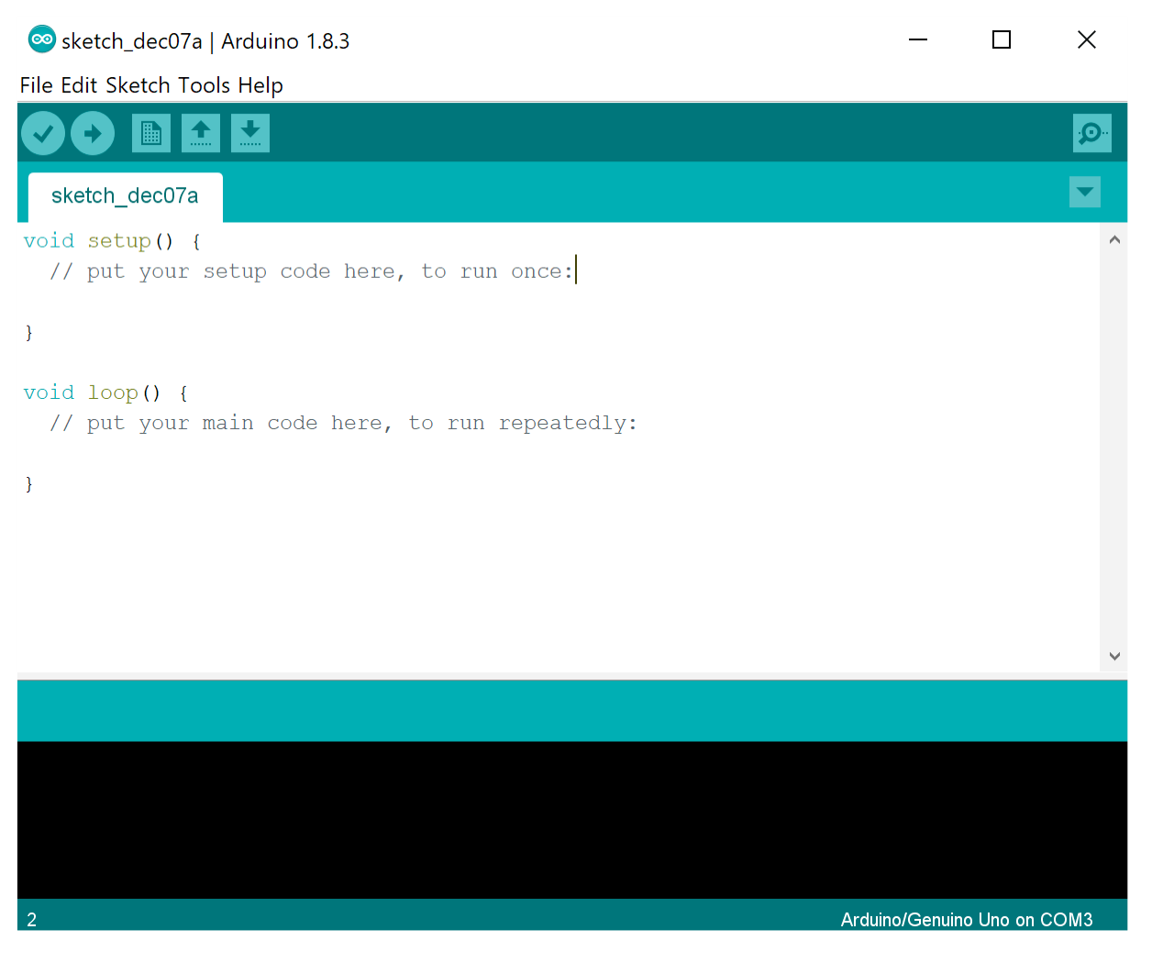
SOFTWARE PLATFORM
OBJECTIVE
INTRODUCTION
LITERATURE SURVEY
SOFTWARE PLATFORM
BLOCK DIAGRAM
CIRCUIT DIAGRAM AND COMPONENTS
RESULT AND ANALYSIS
FUTURE ASPECTS
CONCLUSION
USING ARDUINO PLATFORM

Slide 8
BLOCK DIAGRAM
OBJECTIVE
INTRODUCTION
LITERATURE SURVEY
SOFTWARE PLATFORM
BLOCK DIAGRAM
CIRCUIT DIAGRAM AND COMPONENTS
RESULT AND ANALYSIS
FUTURE ASPECTS
CONCLUSION
RFID SENSOR
(WE CAN DETERMINE THE ATTENDANCE)
ESP8266
DATABASE
LIBRARIAN
ACKNOWLEDGEMENT
WEBSITE
ISSUE OF BOOKS

Slide 9
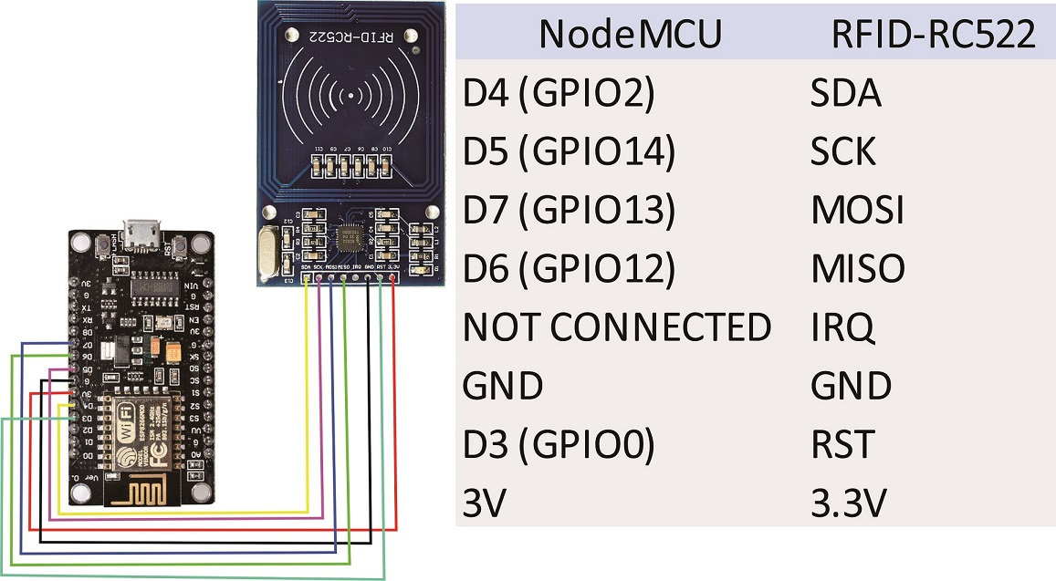
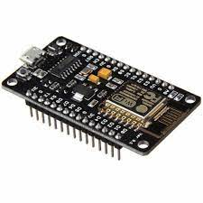
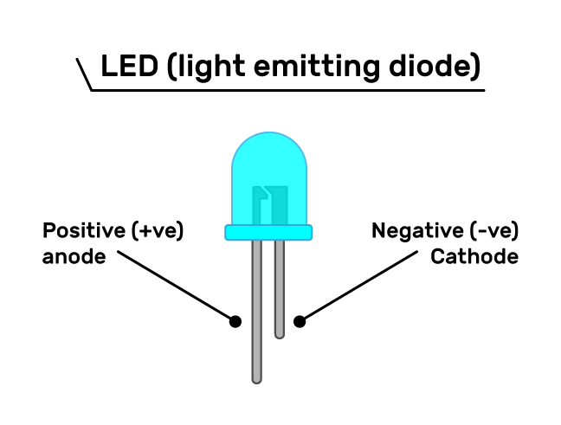
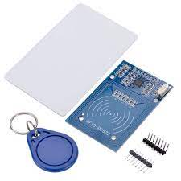
CIRCUIT DIAGRAM
AND COMPONENTS
OBJECTIVE
INTRODUCTION
LITERATURE SURVEY
SOFTWARE PLATFORM
BLOCK DIAGRAM
CIRCUIT DIAGRAM AND COMPONENTS
RESULT AND ANALYSIS
FUTURE ASPECTS
CONCLUSION

Slide 10
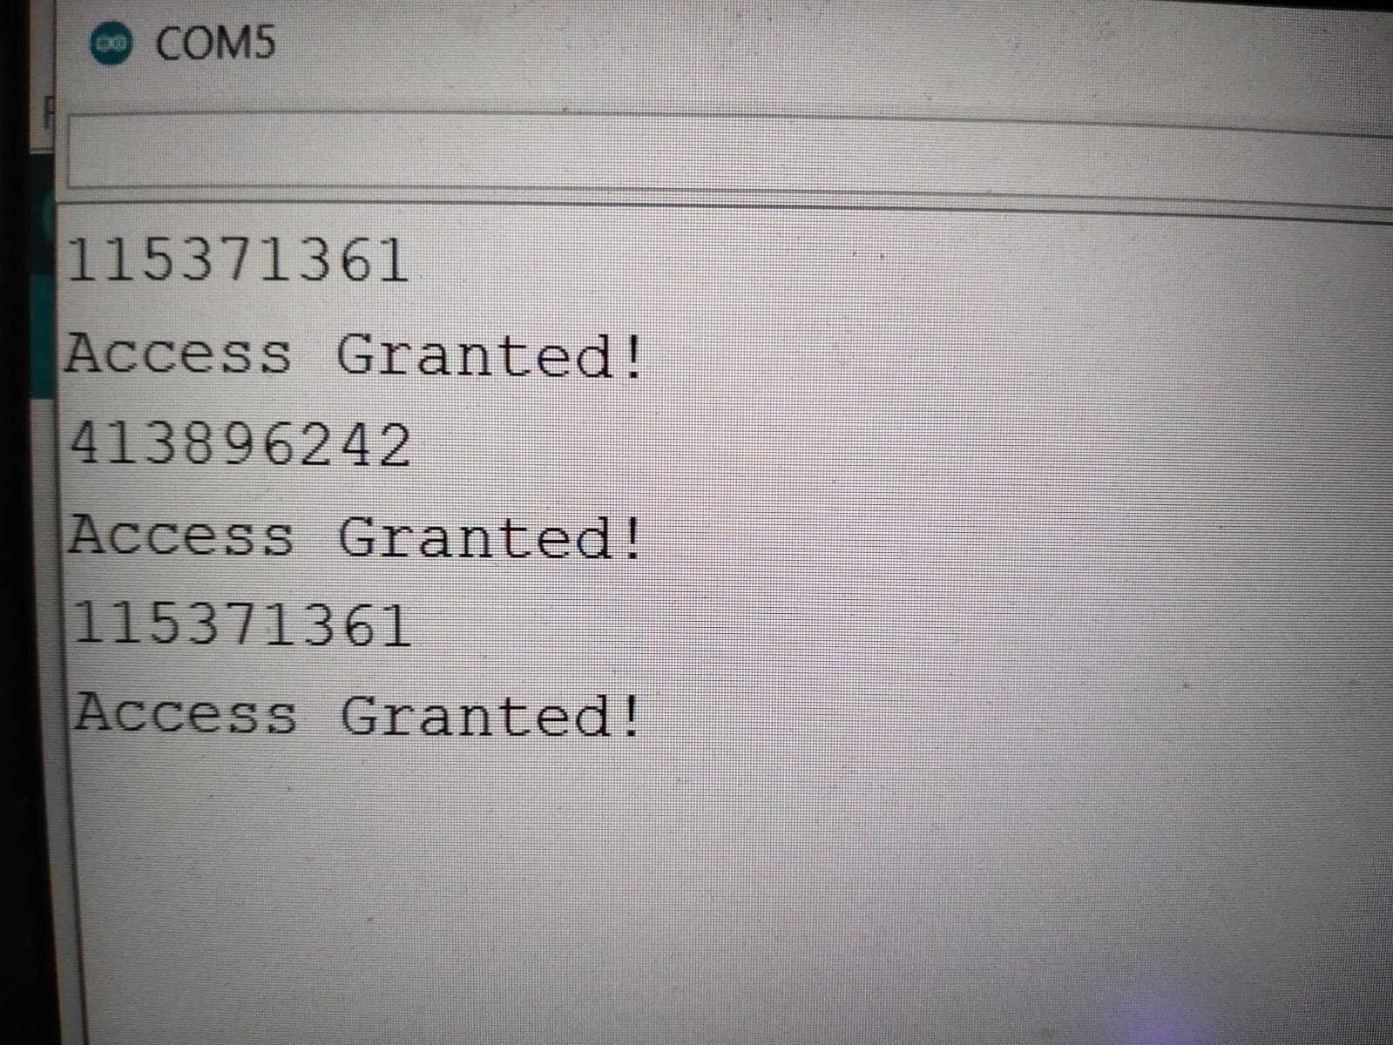
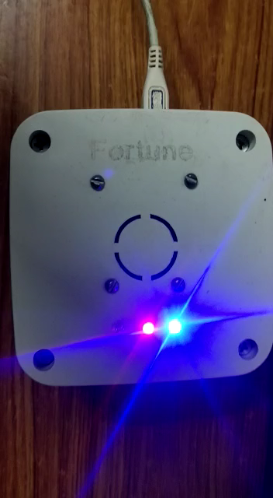
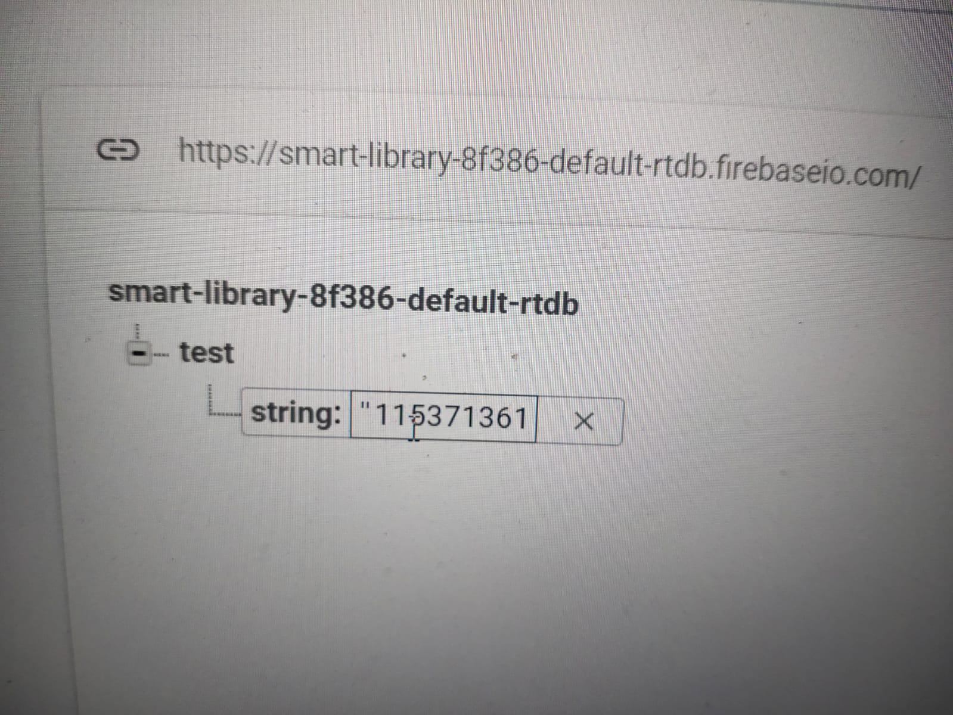
RESULTS AND ANALYSIS
OBJECTIVE
INTRODUCTION
LITERATURE SURVEY
SOFTWARE PLATFORM
BLOCK DIAGRAM
CIRCUIT DIAGRAM AND COMPONENTS
RESULT AND ANALYSIS
FUTURE ASPECTS
CONCLUSION

Slide 11
FUTURE ASPECTS
OBJECTIVE
INTRODUCTION
LITERATURE SURVEY
SOFTWARE PLATFORM
BLOCK DIAGRAM
CIRCUIT DIAGRAM AND COMPONENTS
RESULT AND ANALYSIS
FUTURE ASPECTS
CONCLUSION
RECOMMENDATION SYSTEM
UTILIZATION OF SOFT COPY BOOKS OF EMINENT WRITER
PEERS DISCUSSION
REVIEW SYSTEM/RANKING SYSTEM

Slide 12
CONCLUSION
OBJECTIVE
INTRODUCTION
LITERATURE SURVEY
SOFTWARE PLATFORM
BLOCK DIAGRAM
CIRCUIT DIAGRAM AND COMPONENTS
RESULT AND ANALYSIS
FUTURE ASPECTS
CONCLUSION
REMOTE ACCESS OF LIBRARY
UTILIZATION OF IOT TECHNOLOGY
REDUCTION OF HUSSLE IN ISSUING A BOOK
EASY WAY TO KEEP A TRACK OF LIBRARY ATTENDANCE

Slide 13
THANK
YOU

